Slide 1
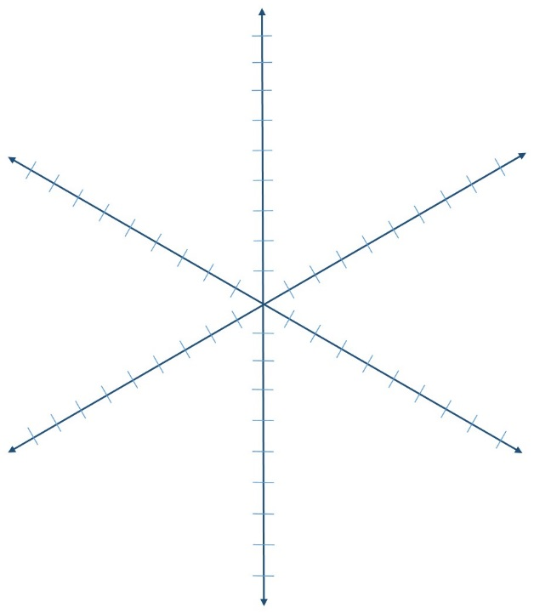
Gweithdy Dylunio Dysgu ABC
Rhaglen:
Enw'r modiwl:
Adolygiad modiwl / modiwl newydd:
Staff y modiwl:
Dyddiad y gweithdy:
Caffaeliad
Cynhyrchu
Cydweithio
Crynodeb o'r modiwl (disgrifiad maint trydar o’ch modiwl):
Ymarfer
Trafodaeth
Ymchwiliad
Graffau mathau o weithgareddau dysgu
@ABC_LD
Sut ydych chi'n rhagweld y bydd eich modiwl yn edrych ar y graff uchod? (mewn coch - ar ddechrau'r gweithdy)
Graff gweithgaredd eich modiwl ar ddiwedd y gweithdy (mewn glas)
Ar lein
Wyneb i wyneb
Graff Cyfunol
Ble ydych chi am fod ar y raddfa (mewn coch)
Beth yw eich sefyllfa ar ddiwedd y gweithdy (mewn glas)
Learning types, Diana Laurillard, IoE 2012 | Connected Curriculum, Dilly Fung, CALT, 2014 | ABC curriculum design workshop and resources, Clive Yung and Natasa Perovic, ELE, 2015 | UCL

Slide 2
Arena Blended Connected (ABC) learning design workshop
Programme
Module name
new module / module review
Academics
Acquisition
Production
Collaboration
ELE workshop facilitators
Workshop date
Module summary (tweet size description of your module):
Practice
Discussion
Investigation
Learning types activities graph
@ABC_LD
How do you envisage your module will look on the graph above? (in red - at the beginning of the workshop)
Your module activity graph at the end of the workshop (in blue)
online
face to face
Blended graph
Where do you want to be on the scale (in red)
What is your position at the end of the workshop (in blue)
Learning types, Diana Laurillard, IoE 2012 | Connected Curriculum, Dilly Fung, CALT, 2014 | ABC curriculum design workshop and resources, Clive Yung and Natasa Perovic, ELE, 2015 | UCL

